Slide 1
Dissertation/Thesis Guidelines
Graduate School of Biomedical Sciences
Fall 2022 Workshop

Slide 2
Conferral Dates
December 2022
February 2023 (Must register for Spring 2023)
February 2023 (In Absentia)
May 2023
June 2023
August 2023 (Must register for Fall 2023)
August 2023 (In Absentia)
Timelines are available on the GSBS Graduation Information site

Slide 3
In Absentia
Students must be registered for the semester in which they graduate, and all fees and tuition apply. In Absentia status is a type of registration students who have completed all requirements for graduation to enroll for purposes of a degree conferral.
For August or February In Absentia conferral notify Tiffany Thompson and Dr. Raabe
Students must have defended in line with August or February In Absentia Conferral timeline to qualify.
Submit a PDF Add/Drop enrollment form for INTD 1000 with COGS Chair and Mentor signature to Tiffany Thompson prior to the first day of classes for the new semester.

Slide 4
Important Dates
1 month prior to defense – Submit dissertation/thesis to Canvas TurnItIn course. Submit Similarity Report along with dissertation to Supervising Professor
2 weeks prior to defense
  – Submit dissertation/thesis to Research Supervisory Committee
– Submit the following forms to IMPACT
  Form 40 - Signed Request for Final Oral Exam (**Must be fully signed one week prior to defense or your defense will be rescheduled**)
  Upload your abstract and CV with Form 40
2 weeks after defense – Submit final dissertation/thesis to Canvas TurnItIn course and ProQuest for editing

Slide 5
Important Dates
At least 1 week before GFC meeting to approve degrees
  Request for Report on Final Defense and Oral Examination (Form 43/41) in IMPACT
  Signature Page/Approval Page (on paper – original or electronic signatures accepted)
    The fully signed approval page including the Deans’ signature will be added to the final thesis/dissertation in ProQuest after GFC.
  Formatting edits completed in ProQuest, Post-Grad survey completed
*Both forms will be submitted without the Dean’s signature. Following Degree Approval by GFC, the Dean will sign

Slide 6
TurnItIn Course and Report
Students who applied for graduation will be added to GSBS Turnitin course in Canvas
Upload “Initial Submission” 1 month before defense
  Email Similarity Report to PI
Meet with PI to discuss any major findings of similarities if necessary
Upload “Final Submission” within 2 weeks following defense
  Same version should be uploaded to ProQuest
  All formatting edits in ProQuest must be completed at least one week prior to GFC.
*The TurnItIn process is not meant to be punitive but is meant to assist our students with submitting original work and ideas, to support our academic integrity policies, and to uphold our institutional reputation.

Slide 7
Similarity Report
Report will give students an overall percentage of similar text found within submission
These colored tabs are seen on the side of your submission in Canvas as well as in the Grades section
GSBS Acceptable Range: 0-24%
Ranges:
  Blue: 0% matching text
  Green: 1 – 24% matching text
  Yellow: 25 – 49% matching text
  Orange: 50 – 74% matching text
  Red: 75 – 100% matching text

Slide 8
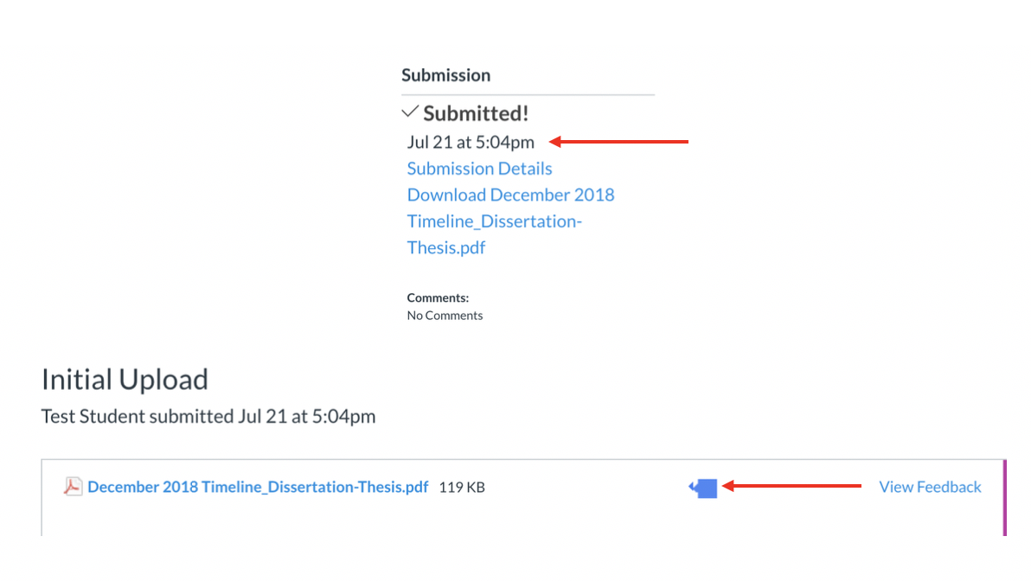
How to Access the Report
Click Submission Details on the righthand corner
Click blue icon next to document name

Slide 9
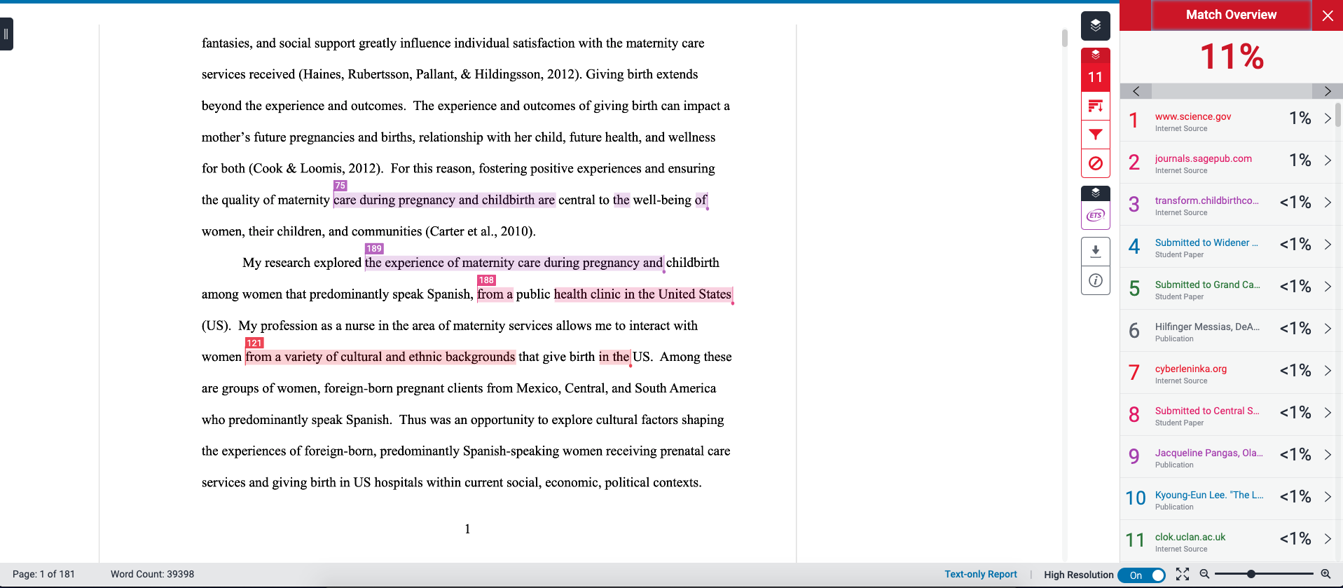
Example of Similarity Report

Slide 10
Turnitin is flagging my previous work
Contact Alex De Jesus to exclude these sources from your similarity report
  This will need to be done for both initial and final uploads
  New score will be reflected in Similarity Report but not in Canvas

Slide 11
General Format of Paper
Rubric, templates, examples, and other resources are available on GSBS Dissertation site

Slide 12
Using Third Party Content
Must obtain written permission from owner of work (sample letter on site)
  Written permission must be submitted to the Graduate Dean office
If unable to obtain permission:
  Redraw/trace maps, images, graphics, etc.
  Redact image and reference where it can be found (URL, journal, etc.)

Slide 13
What If I Want To Use My Previous Work?
Determine who owns copyright:
  Copyright held by publisher
    Obtain permission from publisher
  Copyright held by author (yourself)
    Should be free to use work
  Copyright held by two or more authors
    Obtain permission from co-author(s)
Add a footnote to section where material is used to show permission

Slide 14
ProQuest Requirements
Dissertation Committee members are identified
Keywords and subject categories are identified
Copyright Disclaimer signed and uploaded
Document is uploaded as a PDF file with the following specifications:
  1. Optimized for printing
  2. No security settings
  3. All fonts are embedded into file
  4. Images/graphics resolution of at least 600 dpi

Slide 15
Things to Consider During ProQuest Submission
What kind of publishing do you want?
Is there sensitive information/unpublished data in your paper?
Do you want to copyright your work?
Do you want to order physical bound copies of your paper?

Slide 16
Publishing Your Work
ProQuest (PQ)
  Traditional Publishing
  Open Access ($95)
Institutional Repository (IR)
  Work will be published in UTHSCSA’s school repository

Slide 17
Embargo/Delayed Release
Can be used if student is awaiting patent or if paper contains unpublished/sensitive data
GSBS allows up to a 1 year delay
  Students can request a 2 year delay by emailing Dr. Tim Raabe a justification for the delay. Please be sure to copy your PI on the email.
Submission will not be discoverable in ProQuest or Google Scholar

Slide 18
Copyright
Optional (should be discussed with your PI)
Can be purchased on ProQuest ($75)
  Must be added during initial submission creation
  If there is an existing copyright, you don’t need to purchase another
Adding copyright later?
  Option 1#: Create a brand new submission
  Option 2#: File through www.copyright.gov

Slide 19
Physical Bound Copies
Be sure to add a blank fly paper to the beginning of your paper
ProQuest (Price varies on materials)
  Must be purchased* during initial submission
Third Party Sites
  PhD Book Binding (https://phdbookbinding.com/)
  Thesis On Demand (https://www.thesisondemand.com/)
  Book1One (https://www.book1one.com/Academic-Books/Theses-Dissertations)
  *Departments are currently unable to purchase copies with a PID or a ProCard. All orders must be made with a credit card that allows tax.

Slide 20
What happens once my submission has been approved?
Survey of Earned Doctorate (SED) certificate [Ph.D. only]
GSBS Post Graduation Survey which includes:
  Name of Post Grad Organization
  LinkedIn URL (if available)
  Phone contact
  Non-UTHSCSA email
  Forwarding address
Sign up for GSBS Alumni Site
Complete GSBS IPE-A Post Survey
*Items above must be complete before GFC meeting in order for student to be presented for degree conferral

Slide 21
What if I need to make changes on ProQuest?
Submissions are sent to ProQuest one week after the official conferral date.
Add completed approval page?
  Email Alex De Jesus to open submission
Change physical address? Check on status of physical copies? Need a refund?
  Email ProQuest directly at disspub@proquest.com or call 800-521-0600 press 2, then 1 (M-F from 8AM to 6PM EST)
  Give as much information as possible (order number, full name, etc.)

Slide 22
Resources Available on GSBS Graduation and Dissertation/Thesis Sites
Graduation Site - https://www.uthscsa.edu/academics/biomedical-sciences/student-life/graduation
  Important deadlines & graduation information
Dissertation/Thesis Site - https://www.uthscsa.edu/academics/biomedical-sciences/dissertationthesis-guidelines
  Templates/examples
  Turn-it-in / ProQuest instructions
  Dissertation rubric
  This PowerPoint

Slide 23
Questions?
Who to contact:
  Dr. Tim Raabe, Associate Dean of Academic Affairs (Overall Process)
  Tiffany Thompson, Manager of Academic Programs (IMPACT, defense paperwork, announcement etc.)
  Alexandra De Jesus, Statistician (ProQuest, Canvas, Formatting)

